Slide 1
Utilization Management
Author
Institutional Affiliation
Instructor
Course code
Date of submission

Slide 2
Introduction
Utilization management refers to a complex process particularly designed to improve the quality of healthcare while reducing costs and improving the overall health of the population (Huck & Lewandrowski, 2014).
Observably, on a case by case basis, UM evaluates the efficiency and appropriateness of all the treatments, procedures and services provided to the patients.
Utilization management evaluates a wide range of medical services that include inpatient admissions, skilled nursing facility admissions, home health visits, outpatient visits and ER visits.
It is essential to understand that the process carefully analyses the costs involved in each of the healthcare provided to the patients. UM ensures that healthcare costs remain low.

Slide 3
Importance of Utilization Management
One of the key goals of utilization management is to ensure that healthcare-related costs are kept low at their minimums.
Ideally, the process evaluates the effectiveness of treatments for each patient during and after the treatments consequently ensuring that besides reduced healthcare costs, patients receive improved quality care (Weiner, 2021).
Utilization management in healthcare is also focused on ensuring the improved overall health of the population, admittedly, reviewing patient information regarding their treatments ensures that physicians and healthcare providers give their best to consequently improve the overall health of the population.

Slide 4
Cont..
Reviewing patient treatment plans significantly reduces denials.
Using information and metrics gathered during retrospective surveys, insurance companies and other third-party payers are more likely to approve these treatment plans as prescribed by the physicians.
Kapur et al. (2003) argued that the primary goal of utilization management is to ensure patients receive effective care, delivered to them promptly at reasonable costs with fewer or no cases of denials.
State and federal actors have embarked on creating reforms ensure that patients have the opportunity of having their claims reconsidered in case of denials.
Based on the data presented by Kapur et al. (2003), 42% of the prospective requests at MG1 were denied because the services fell out the scope of benefits covered by the insurers. Similarly, another 29% were also denied because the reviewers thought they were not medically necessary.

Slide 5
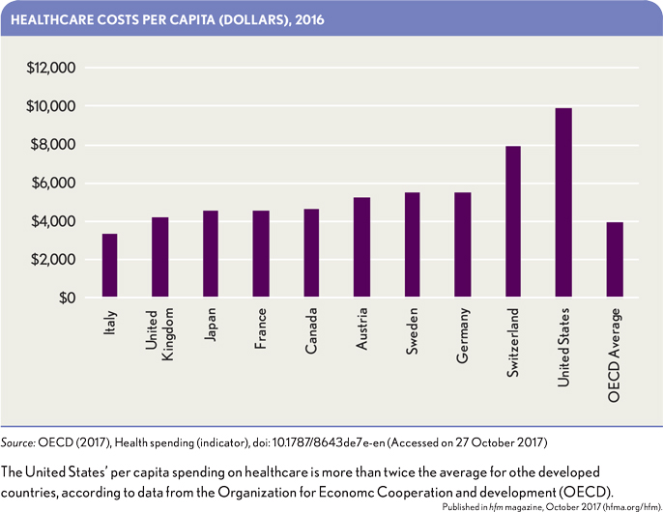
US has had the highest spending in healthcare over the last few Years

Slide 6
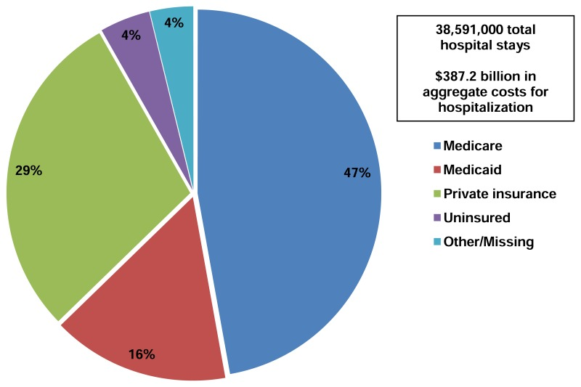
UM ensures financial accountability between the insurers, the patients and the healthcare providers

Slide 7
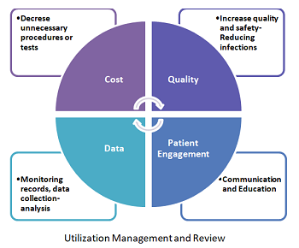
Impacts of Utilization management in healthcare

Slide 8
Types of utilization management
Utilization management mainly has three types of reviews conducted during the evaluative process. Each of the reviews presents a unique impact on the UM process. These include:
Prospective Reviews
Prospective reviews are performed before physicians begin their treatment plans. However, in some situations, prospective reviews may be done at the onset of treatments.
The key purpose of this review is to eliminate unneeded services. Even though the initial treatment plans chosen by the providers can be changed later, it is essential to note that these should be considered contingent.
Prospective reviews are also known as precertification or pre-admission reviews. Denials of coverage may at times occur due to disagreements on contractual issues.
As observed by Kapur et al. (2003), denials on requests for inpatient care were observably low.

Slide 9
b. Concurrent Reviews
Concurrent reviews are particularly meant to keep track of the ongoing medical procedures on patients during treatments and monitor resource consumption.
In some occasions, concurrent reviews may lead to stoppage of some in-process care procedures.
During concurrent reviews may present the attending physicians with alternatives which are arguably cost-friendly or even discharge against the treating physician’s will. This may result in conflicts between the insurers, the providers and the patient.
Also referred to as admission reviews or the continued stay review.

Slide 10
C. Retrospective reviews
Retrospective reviews are usually carried out after the completion of treatment plans on patients.
Tellingly, as argued here, the main aim of this review is to assess the appropriateness and the efficiency of the treatment plans provided to the patients.
Retrospective reviews analyses which treatment plans work best in order to establish and generate data for future patients where such treatment plans can be prescribed to patients with similar ailments.
Arguably, this review allows the reviewers to find fault with the treatment plans and successes which they send back to the primary care providers.
. Data presented in the article indicates that retrospective requests were nearly four times more likely than prospective requests to be denied, and when prospective requests were denied, it was more likely because the service fell outside the scope of covered benefits than because it was not medically necessary.

Slide 11
Based on these reviews, the financial burden may fall on caregivers in situations where proven treatment plans were not utilized since insurers are more likely to deny such claims.
Observations at the two capitated medical groups indicated that prospective were more likely to be denied based on the medical necessities of the services proposed by the physicians.
Between the two medical groups, preauthorization requests accounted for a sizable share of the request for services by the patients. 4/5 of the requests were prospective requests.
Denial rates were observably low for the two groups. However, denials for retrospective requests were based on coverage for the services by the insurers. Ancillary heath services and diagnostic services represented a denial rate of above 40% for the two medical groups .

Slide 12
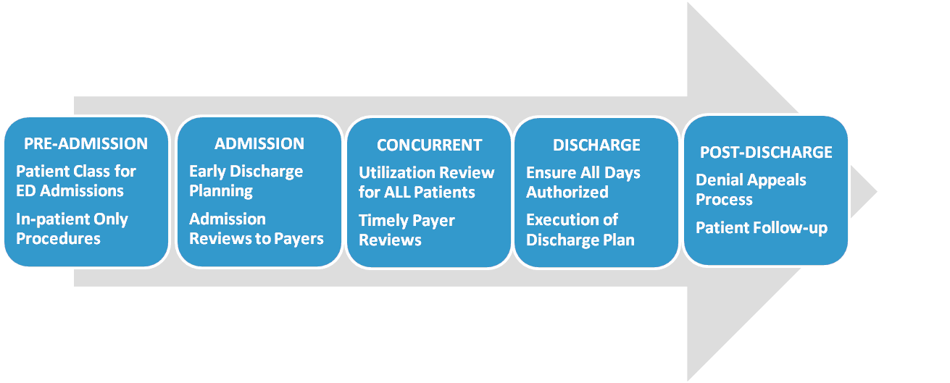
Typical UM process in healthcare facilities

Slide 13
Utilization management and denials
Utilization management ensures that treatment plans offered to the patients are evaluated and approved to significantly limit the chances of denials.
For instance, after a physician has recommended surgery for a patient, reviewers may look between inpatient surgery or outpatient surgery.
Efficient communication between care providers and insurers considerably reduces the chances of a claim being denied.
Based on the data presented in the article, 42% of the prospective requests at MG1 were denied because the services fell out the scope of benefits covered by the insurers. Similarly, another 29% were also denied because the reviewers thought they were not medically necessary.

Slide 14
Cont.…
As observed, most requests are usually denied because the requested services are not covered within the insurance contract policies.
Contractual policy issues continue to be a leading reason for denials of prospective requests followed by medical necessity.
As indicated in the article, all emergency care denials were made based on medical necessity.
Also, concerning retrospective requests, all the denials at MG1 were observably due to the fact that the patient’s conditions were not emergencies. However, others were due to the fact that the patients did not seek preauthorization whereas they needed to.

Slide 15
Utilization and containment of costs
Retrospective reviews in UM keep records and data of successful treatment plans.
Believably, this helps in ensuring that physicians only apply proven and less costly plans for their future patients (Bailit & Sennett, 1992).
Additionally, the gatekeeping system by insurers has also proven to be an efficient measure in managing healthcare costs by ensuring that patients are only referred to less expensive specialists.
The US spending on healthcare has grown much faster than the rest of the economy over the past few decades.

Slide 16
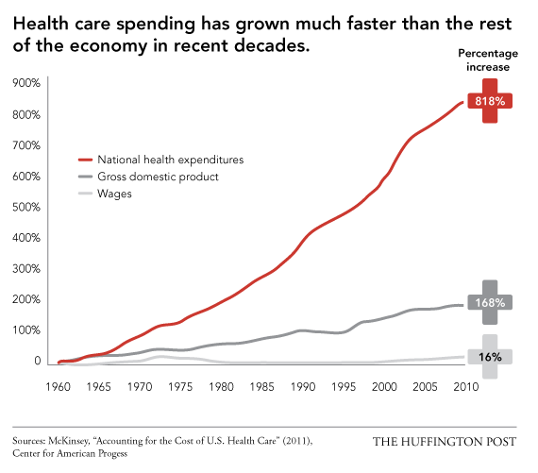

Slide 17
Discussion questions
What are the potential impacts of an active engagement of third-parties such as insurers inpatient care decision making processes?
In UM, what are the responsibilities of healthcare providers and patients?
How does the utilization management program in hospitals limit unneeded utilization and contain costs?

Slide 18
References
Weiner, M. (2021). The Importance of Utilization Management in Healthcare [PODCAST] - BESLER. Retrieved 9 February 2021, from https://www.besler.com/the-importance-of-utilization-management-in-healthcare-podcast/
Kapur, K., Gresenz, C. R., & Studdert, D. M. (2003). Managing Care: Utilization Review In Action At Two Capitated Medical Groups: Prospective denials of coverage on grounds of medical necessity are only a small part of the overall picture. Health Affairs, 22(Suppl1), W3-275.
Bailit, H. L., & Sennett, C. (1992). Utilization management as a cost-containment strategy. Health care financing review, 1991(Suppl), 87.

Slide 19
Huck, A., & Lewandrowski, K. (2014). Utilization management in the clinical laboratory: an introduction and overview of the literature. Clinica Chimica Acta, 427, 111-117.

